Slide 1
Lecture Title: Recursion
Course Code: CSC 2211
Course Title: Algorithms
Dept. of Computer Science
Faculty of Science and Technology
Lecture No: | 03 | Week No: | 03 | Semester: | Spring 20-21
Lecturer: | Name: Mushfiqur Rahman; E-mail: mushfiqur@aiub.edu

Slide 2
Lecture Outline
Divide and Conquer
Recurrences in Divide and Conquer and methodologies for recurrence Solutions
Repeated Backward Substitution Method
Recursion Tree (Next Week)
Master Method (Next Week)

Slide 3
The divide- and- conquer design paradigm
• Divide and conquer is just one of several powerful techniques for algorithm design.
• Divide- and- conquer algorithms can be analyzed using recurrences and the master method.
• Can lead to more efficient algorithms

Slide 4
The divide- and- conquer design paradigm
1. Divide the problem (instance) into sub-problems.
2. Conquer the sub-problems by solving them recursively.
3. Combine sub-problem solutions.

Slide 5
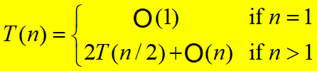
Recurrences
Running times of algorithms with recursive calls can be described using recurrences.
A recurrence is an equation or inequality that describes a function in terms of its value on smaller inputs.
For divide and conquer algorithms:
Example: Merge Sort

Slide 6
The divide- and- conquer design paradigm
Merge sort
1. Divide: Trivial (array is halved).
2. Conquer: Recursively sort 2 subarrays.
3. Combine: Linear- time merge.
Recurrence for merge sort
Let T( n ) = Time required for size n
T( n ) =
Sub-problem
Size (n/2)
2
*
T( n / 2)
+
n
Number Of Subproblems
Time required for each Subproblem
Work Combining
*
+

Slide 7
The divide- and- conquer design paradigm
Binary search
Find an element in a sorted array:
1. Divide: Check middle element.
2. Conquer: Recursively search 1 sub-array.
3. Combine: Trivial.
Recurrence for binary search
T( n) =
1
*
T( n / 2)
+
1
Number Of Subproblems
Time required for each Subproblem
Work Combining
*
+

Slide 8
Solving Recurrences
Repeated (backward) substitution method
  Expanding the recurrence by substitution and noticing a pattern.
Recursion-trees
Master method
  templates for different classes of recurrences

Slide 9
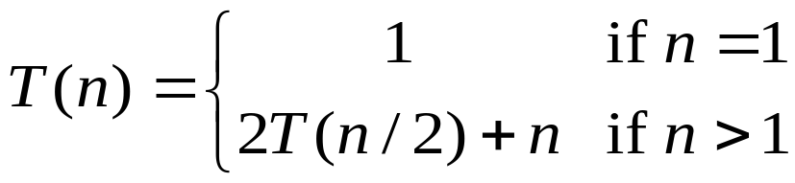
Repeated Substitution
Let’s find the running time of the merge sort
T(n) = 2T(n/2) + n substitute
= 2(2T(n/4) + n/2) + n expand
= 2²T(n/4) + 2n substitute
= 2²(2T(n/8) + n/4) + 2n expand
= 2³T(n/8) + 3n observe pattern
= 2³T(n/2³) + 3n observe pattern
T( n ) = 2^{k}T(n/2^{k}) + kn
= n T(n/n) + n lg n
= n + n lg n
In order to get base case, T(1)…
n = 2^{k}
K = log₂n = lg n
T(n) = O(nlgn)

Slide 10
Repeated Substitution Method
The procedure is straightforward:
  Substitute, Expand, Substitute, Expand, …
  Observe a pattern and determine the expression after the k-th substitution.
  Find out what the highest value of k (number of iterations, e.g., lg n) should be to get to the base case of the recurrence (e.g., T(1)).
  Insert the value of T(1) and the expression of k into your expression.

Slide 11
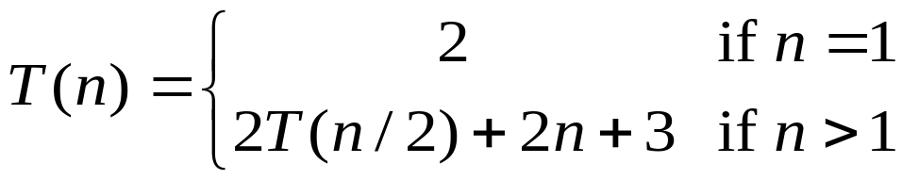

Another Example…
In order to get base case, T(1)…
n = 2^{k}
K = log₂n = lg n
T(n) = 2T(n/2) + 2n + 3 substitute
= 2(2T(n/4) + n + 3) + 2n +3 expand
= 2²T(n/4) + 4n + 2x3 + 3 substitute
= 2²(2T(n/8) + n/2 + 3) + 4n + 2x3 + 3 expand
= 2³T(n/2³) + 2x3n + 3x(2²⁺2¹⁺2⁰) observe pattern
T(n) = 2^{k}T(n/2^{k}) + 2nk + 3
= 2^{k}T(n/2^{k}) + 2nk + 3 (2^{k}-1)
= nT(n/n) + 2n lg n + 3(n - 1)
= 2n+2n lg n + 3n - 3
= 5n + 2n lg n – 3
T(n) = O(nlgn)

